Slide 1
Multiple Sequence Alignment
Analysis Module

Slide 2
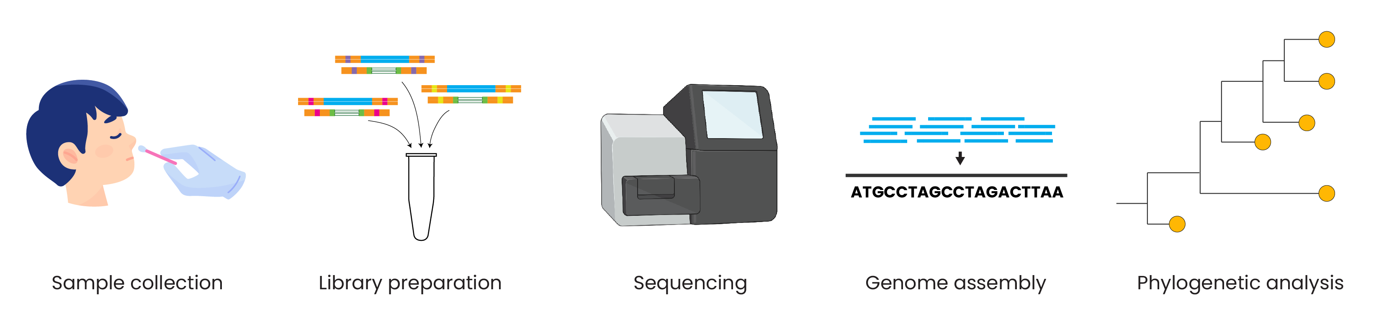
Genomic epidemiology workflow
BioRender.com
Pixel True https://www.pixeltrue.com/about, CC BY-SA 4.0, via Wikimedia Commons
Notes:
Feedback:
- I’ll provide an overview figure to add here!

Slide 3
Genomic epidemiology workflow
1
Build a background dataset
Multiple sequence alignment
Run phylogenetic analysis
2
3
BioRender.com
Pixel True https://www.pixeltrue.com/about, CC BY-SA 4.0, via Wikimedia Commons

Slide 4
Genomic epidemiology workflow
1
Build a background dataset
Multiple sequence alignment
Run phylogenetic analysis
2
3
BioRender.com
Pixel True https://www.pixeltrue.com/about, CC BY-SA 4.0, via Wikimedia Commons

Slide 5
What is Sequence Alignment?
Sequence alignment is the procedure of arranging two or more sequences (DNA, RNA, or A.a. (proteins)) to identify regions of similar or different character patterns.
Sequence similarity could be a result of functional, structural, or evolutionary relationships between the sequences
One goal of sequence alignment is to enable inference of homology (origin from common ancestor) through observed shared sequence similarity.
This is cat
This is rat
This is c[r]at
This is goat
This is c[r]at (goat)

Slide 6
Aligning sequences
easy
TCAGGTAGTT TCAGGTAGTT TCAGCTGGTT TCAGCTAGTT TTAGCTAGTT
**********
CCGGGG---A CCGGTG--GT
-CTAGG---A
-CTAGGGAAC
-CTCTG---A
??????????
GCGGCCCA GCGGCCCA GCGTTCCA GCGTCCCA GCGGCGCA
********
TTGACATG TTGACATG TTGACATG TTGACATG TTGACATC
********
An alignment is a hypothesis of positional homology between nucleotide or amino acid bases.
Changes that occur during sequence divergence from common ancestor include:
﻿Substitutions
﻿Deletions
﻿Insertions
nasty

Slide 7
Constructing an alignment
Identify positional homology (homology at the level of nucleotides or amino acids) among the sequences
allow two types of changes:
}
point substitutions
insertions/deletions
how to weight these?
an example: how should these sequences be aligned?
Sequence 1: ATGCGTCGTT
Sequence 2: ATCCGCGTC

Slide 8


Which alignment is correct?
Sequence 1: ATGCGTCGTT
||•|| |||• Sequence 2: ATCCG-CGTC
two substitutions
one indel
Sequence 1: AT--GCGTCGTT
no substitutions
five indels
|| |||||
Sequence 2: ATCCGCGTC---
It is difficult to choose one

Slide 9
Pair-wise Sequence Alignment
﻿Pair-wise sequence alignment maps and compares residues between two sequences
﻿Aligning two sequences has many distinct alignment options possible
﻿The overall goal is to find the alignment that provides the best (optimal) pairing between the two sequences (i.e. maximum residue/character matches, gaps inclusive)

Slide 10
Sequence Alignment Problems: global & local
Sequences can be aligned:
﻿Matching as many characters as possible across their entire length (Global alignment)
﻿The tool for global alignment is based on the Needleman-Wunsch algorithm
﻿Focusing on just the best-matching (highest scoring) regions Local alignment)
﻿The tool for local alignment is based on Smith-Waterman algorithm
﻿Both algorithms are derivatives from the basic progressive programming algorithm (see later).

Slide 11
Sequence Alignment Problems: global & local
Global alignment:
﻿﻿Suitable for sequences that are quite similar more closely related)
﻿﻿Sequences of approximately same length
﻿﻿Global alignment made possible by including gaps either within the alignment or at the ends of the sequences
Local alignment:
Suitable for sequences similar along some of their lengths but dissimilar in others (i.e. sharing several conserved regions of local similarity domains)
Sequences that differ in length
Gaps less tolerated

Slide 12
Pair-wise Sequence Alignment - Optimal
Sequence alignments have to be scored to identify the best one/s among them.
Scoring system can be simple match/ mismatch scheme
(DNA) or for protein comparisons, use of a more sensitive scheme by substitution matrix
Often there is more than one solution with the same score

Slide 13
Optimal Alignment
﻿Alignment algorithm employ scoring scheme to reward matches/similarity, punish mismatches & gaps
﻿Similarity of two sequences- High score
﻿Dissimilarity of two sequences- Low score
﻿Account for substitutions, insertions, deletions

Slide 14
Optimal Alignment: Gaps
It is desirable to allow some gaps to be introduced into an alignment to compensate for insertions and deletions
Gaps come with a cost & process not arbitrary
Several strategies been proposed to penalize for gaps

Slide 15
Treatment of gaps: Penalties
Constant gap penalty, a fixed - ve score "-a" is given as penalty of every gap, irrespective of length. Score rules: Each match +1; The gap -1
Aligning GCTGATTCAT VS GCTTCAT
G C T G A T T C A T
| | | | | | |
G C - - - T T C A T
Score rules: Each match +1; The gap -1
Total score = 7-1 = 6

Slide 16
Treatment of gaps: Penalties
Linear gap penalty, a penalty of "-a" per unit length of a gap. Takes into account the length (L) of each insertion/deletion in the gap
G C T G A T T C A T
| | | | | | |
G C - - - T T C A T
Score rules: Each match +1; Each gap -1
Total score = 7-3 = 4
Constant and linear gap penalties do not consider whether gap is opening or extending.
Gaps at terminal regions treated with no penalty since many true homologous sequences can be of different lengths

Slide 17
Treatment of gaps: Penalties-4
Affine Gap Penalty: Factors in both starting and extending gaps. Total penalty is
G = O + E(L - 1)
where O = start penalty
E = extend penalty
L = gap length.
Advantages:
Starting a gap is costlier than extending one.
Better aligns with evolutionary patterns.
Disadvantages:
Penalty values are arbitrarily selected.

Slide 18
Data: A G T A C Vs G T A A C
Score rules: +1 for match, -2 for mismatch, -3 for gap
4 matches, 1 insertion (+1)
A G T - A C
| | | |
. G T A A C
2 matches, 0 gaps (-4) A G T A C
| | G T A A C
3 matches (2 end gaps) (+1) A G T A C .
| | |
. G T A A C
4 matches, 1 insertion (+1) A G T A - C
| | | |
. G T A A C
Scoring system rewards correct matches while penalizing both mismatches and gaps.

Slide 19
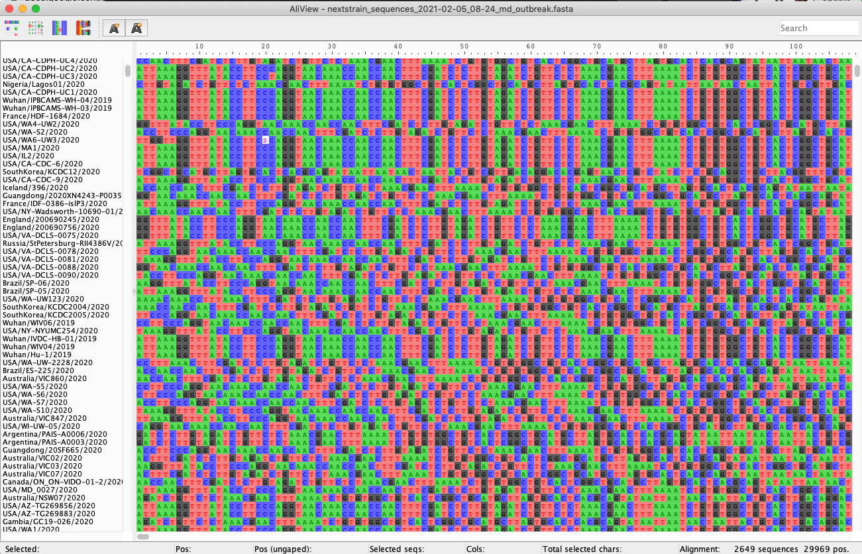
Multiple sequence alignment

Slide 20
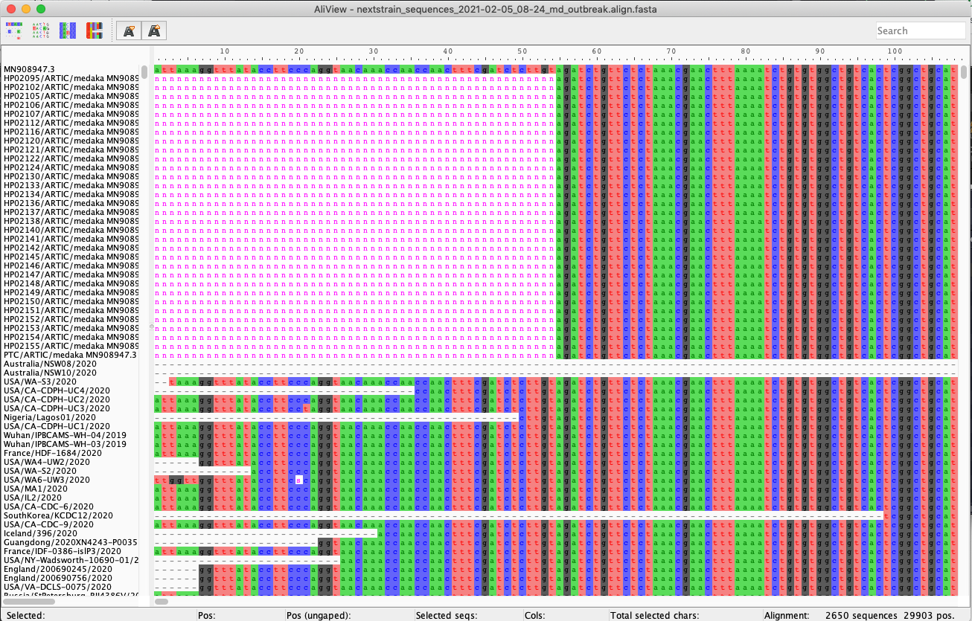
Multiple sequence alignment

Slide 21
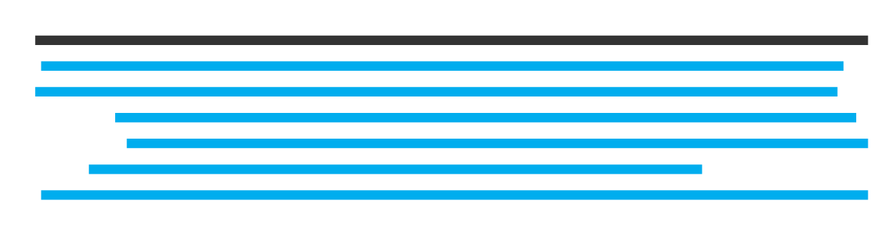

Types of multiple sequence alignment
Alignment with a reference genome
Alignment without a reference genome

Slide 22
Types of multiple sequence alignment
Alignment with a reference genome
Faster and less computationally intensive
Ensures consistent coordinates
Alignment without a reference genome

Slide 23
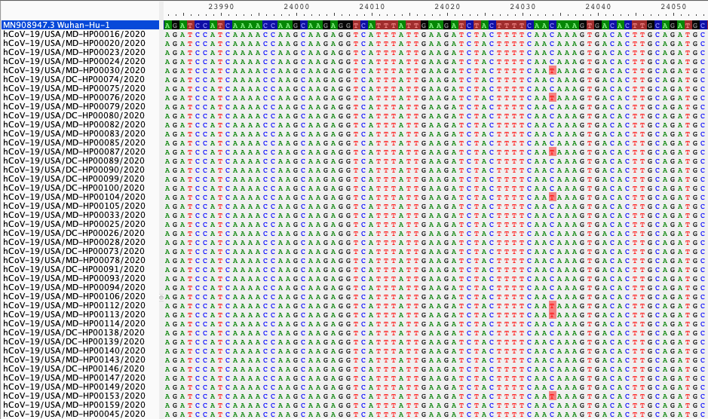
Alignment with a reference genome
Position along reference genome
Reference
genome
Your assembled FASTA files, aligned to the reference
Single nucleotide variants, compared to reference
Aligning to a reference genome gives us a baseline to call variants against

Slide 24
Selecting an appropriate reference genome
Ways to choose a reference genome:
If possible, use the same reference genome as others working on the same outbreak
e.g., Wuhan-Hu-1 for SARS-CoV-2
e.g., Makona-Kissidougou-C15 for Ebola virus
Use the earliest sequence from the outbreak, if available
Use a sequence from a prior outbreak in the same location
Search NCBI RefSeq (https://www.ncbi.nlm.nih.gov/refseq/) for an established reference
The reference genome should always have a date before the earliest of your samples

Slide 25
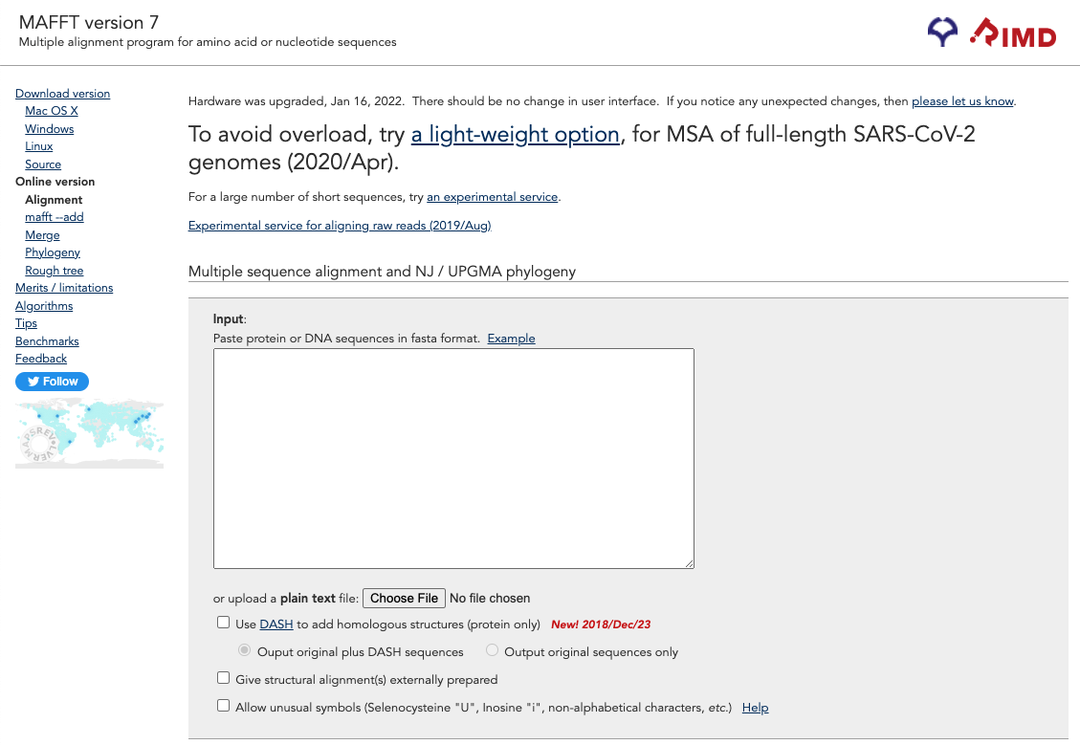

Slide 26
https://mafft.cbrc.jp/alignment/server/

Slide 27
https://mafft.cbrc.jp/alignment/server/

Slide 28
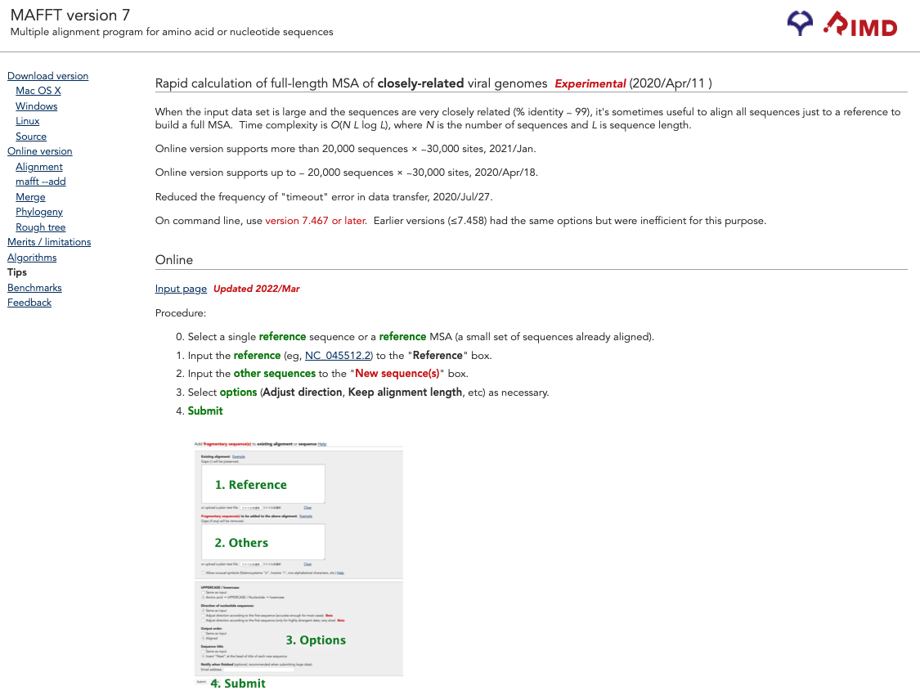

Slide 29
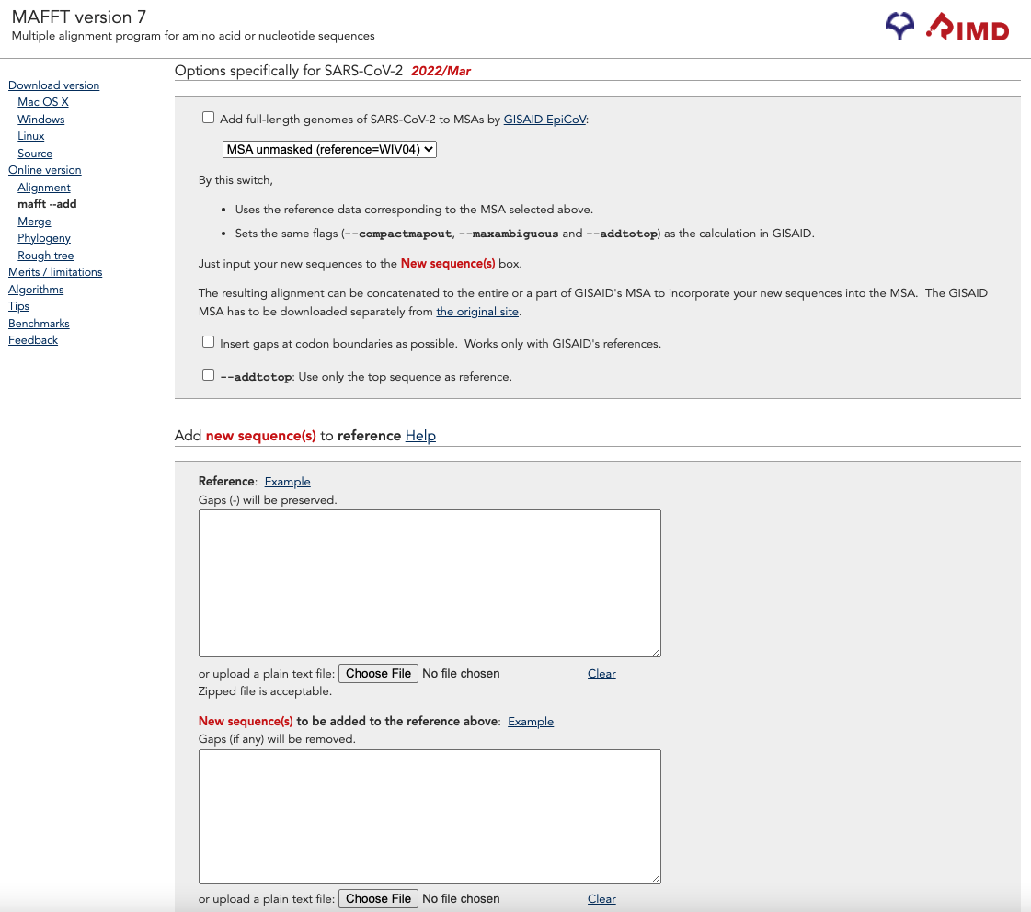

Slide 30
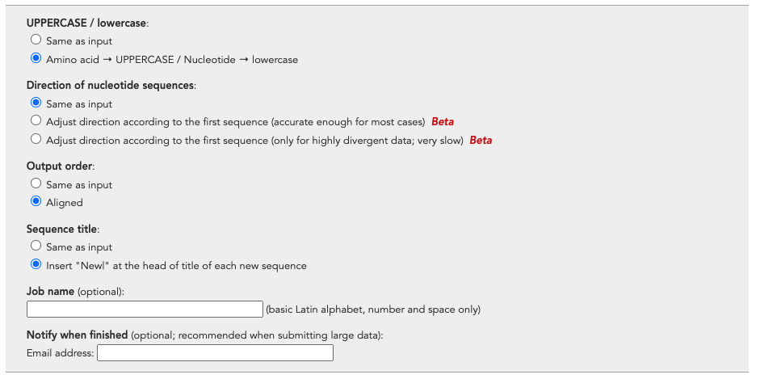

Slide 31
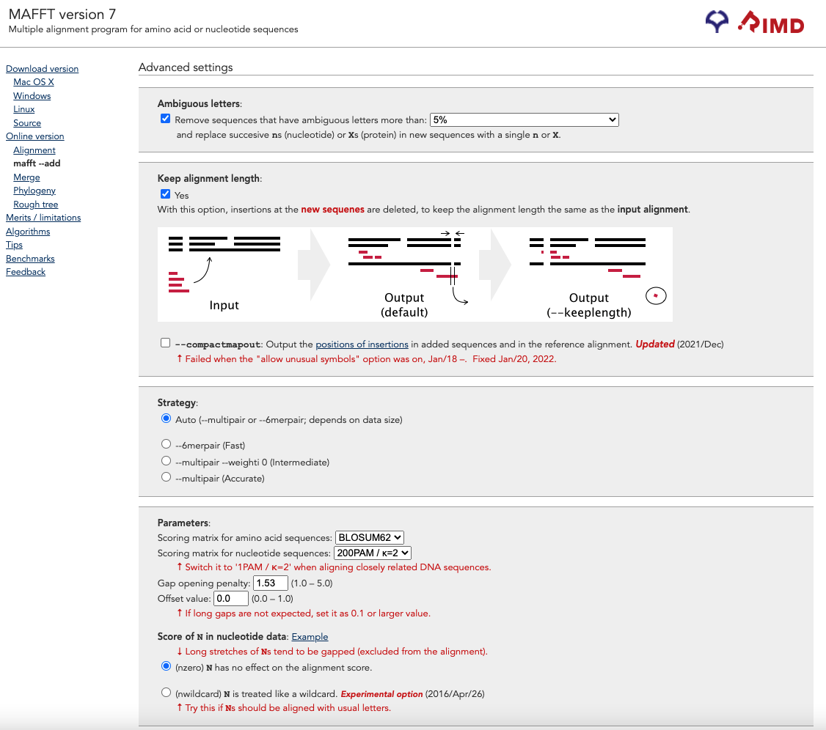

Slide 32
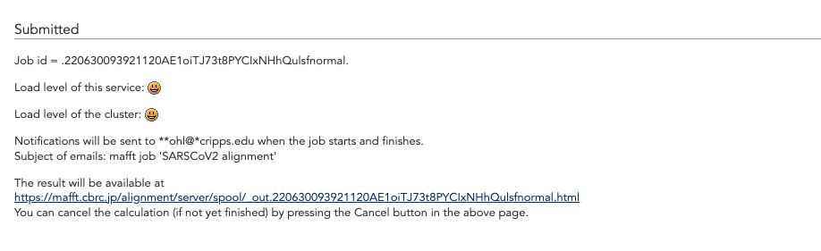

Slide 33
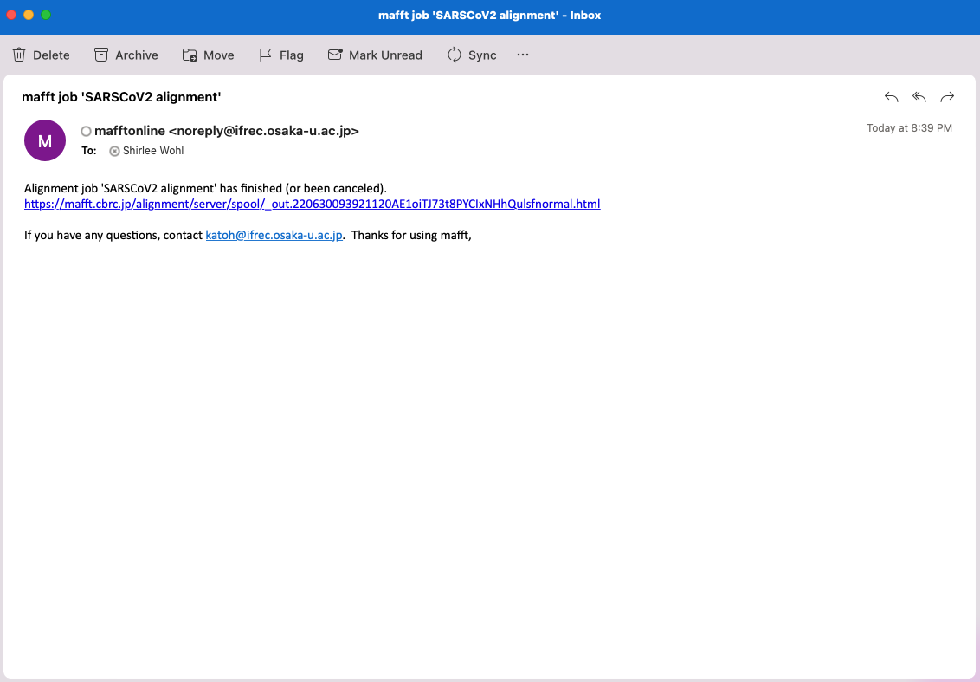

Slide 34
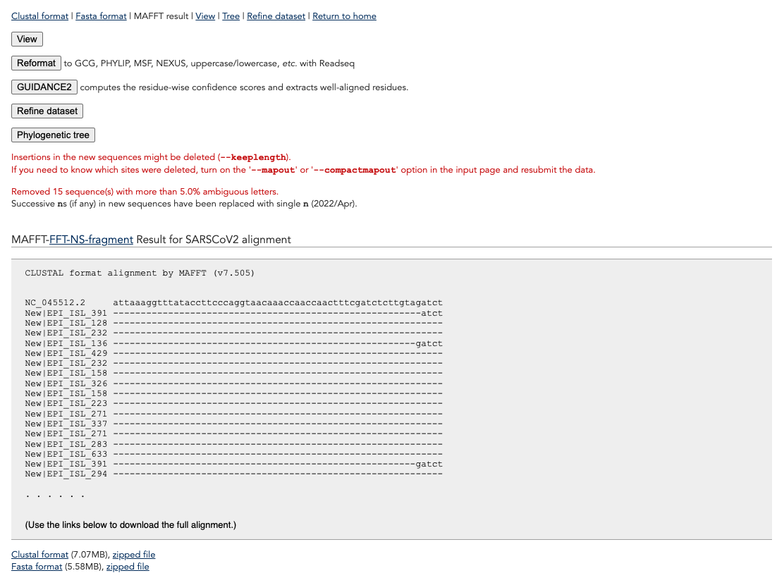

Slide 35
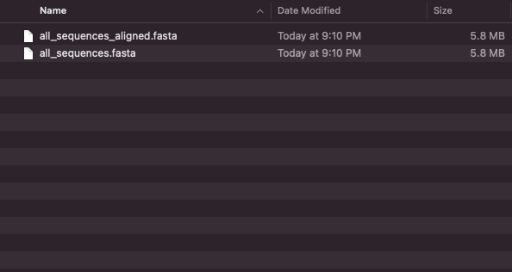

Slide 36
Outline
Types of multiple sequence alignments
Multiple sequence alignment with MAFFT
Inspecting and editing alignments

Slide 37
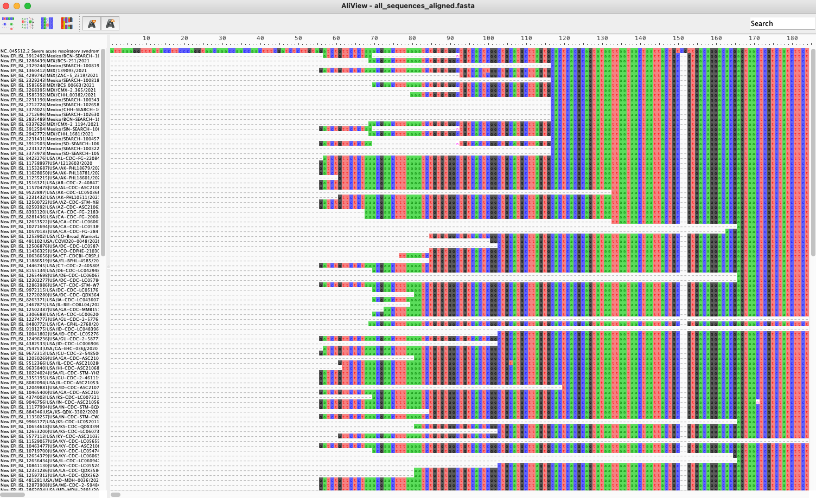
https://ormbunkar.se/aliview/

Slide 38
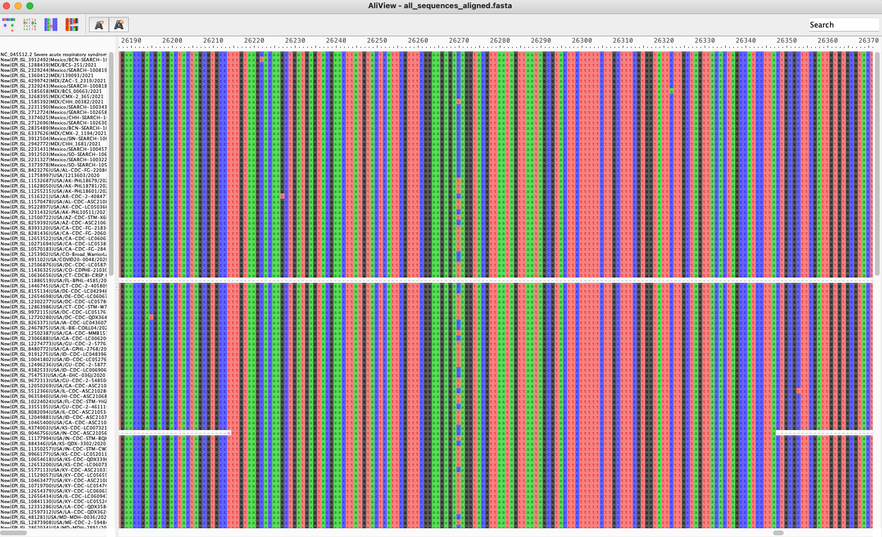

Slide 41
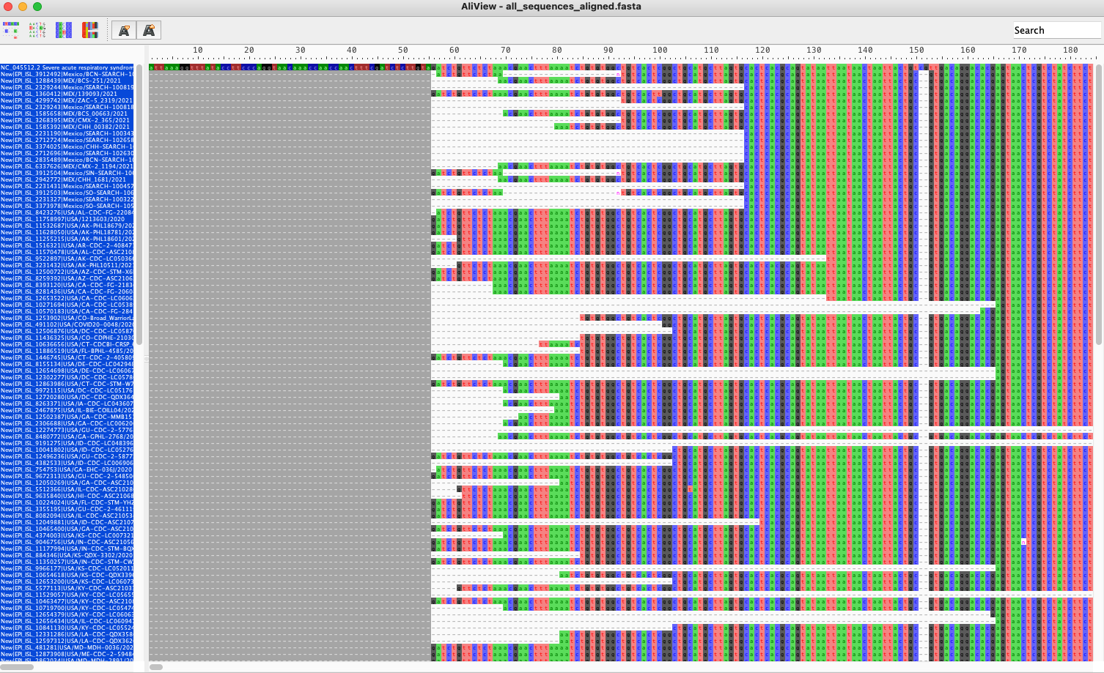

Slide 42
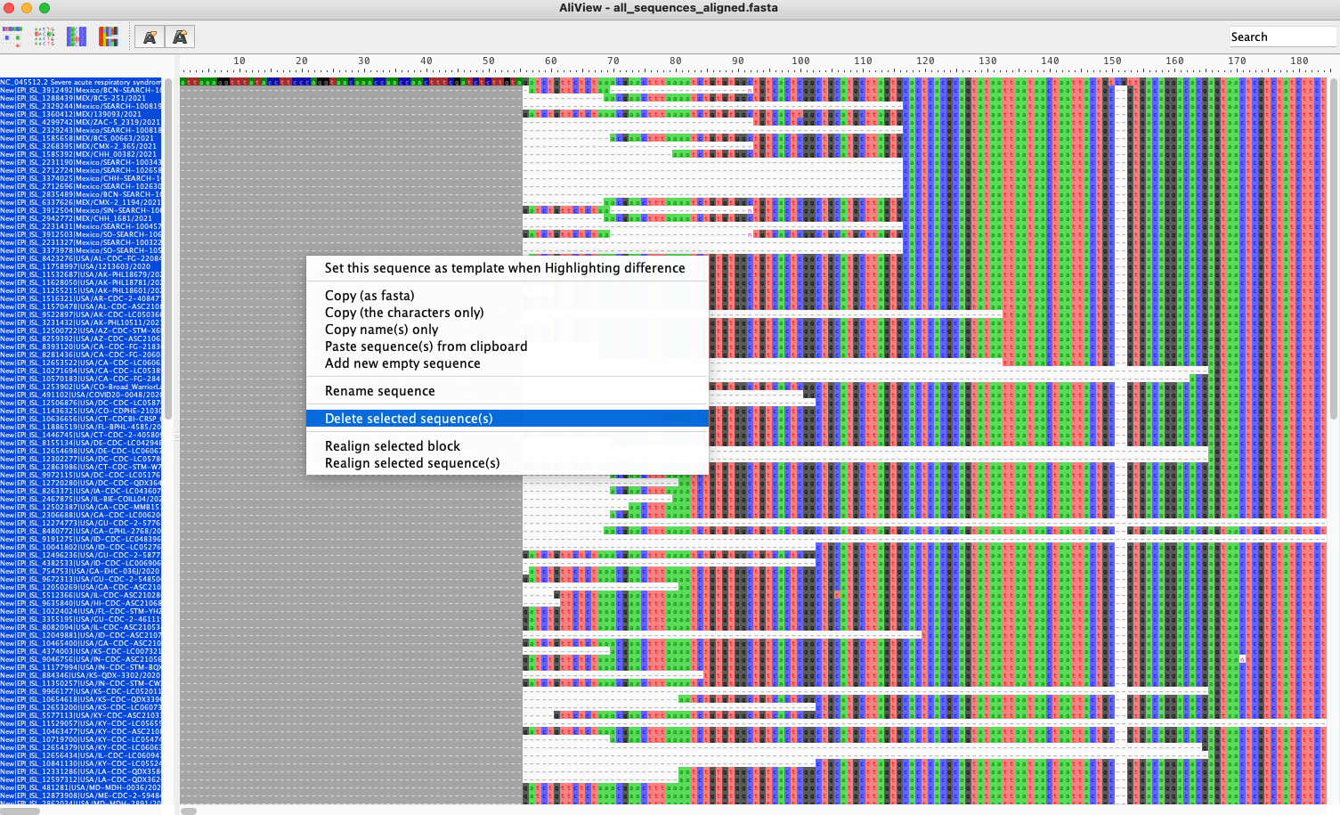

Slide 43
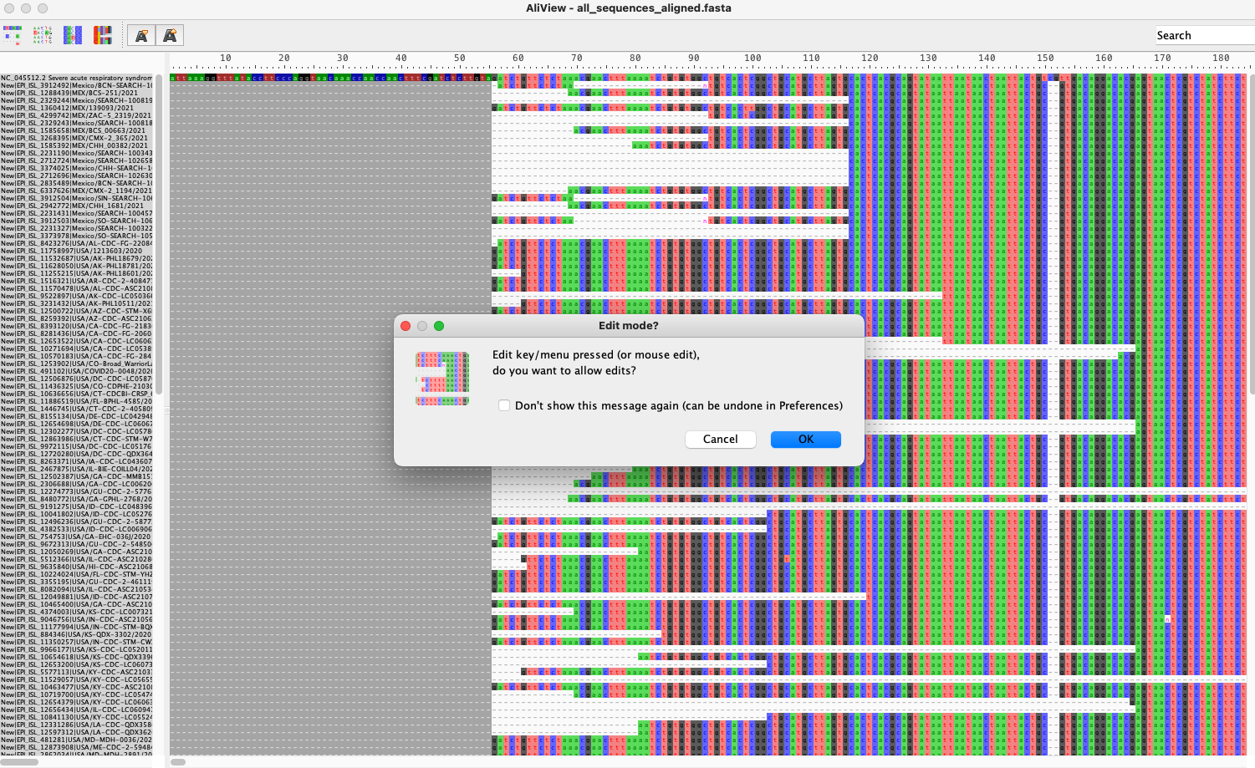

Slide 44
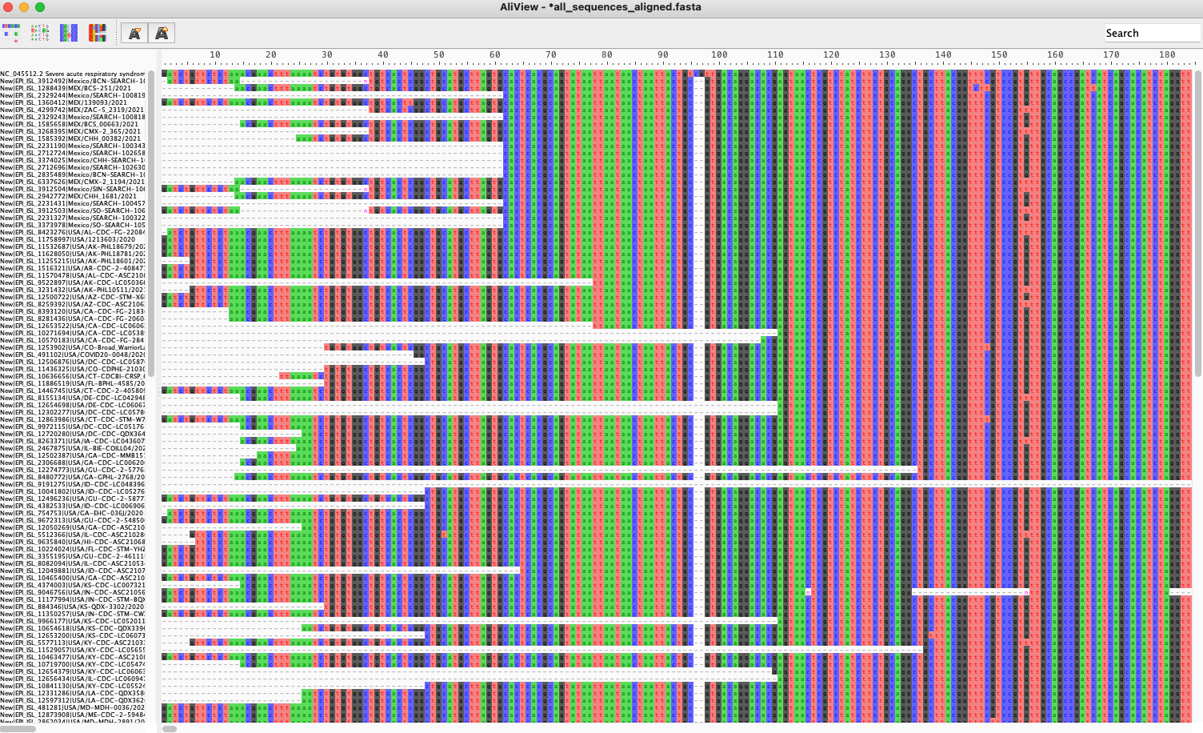

Slide 45
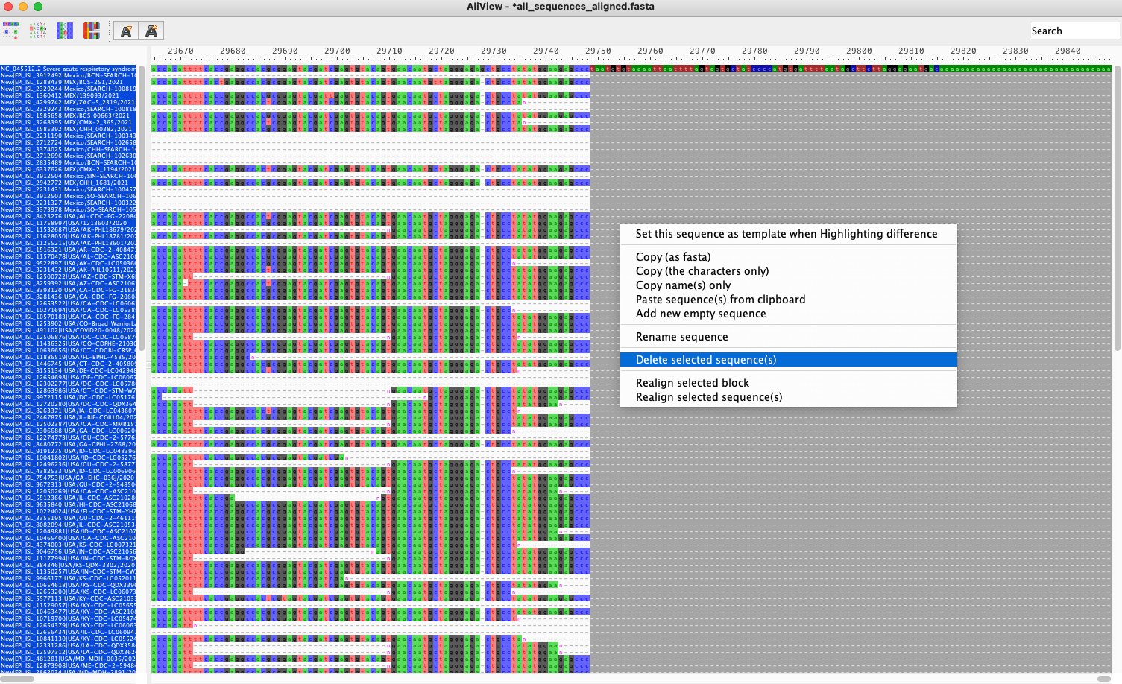

Slide 46
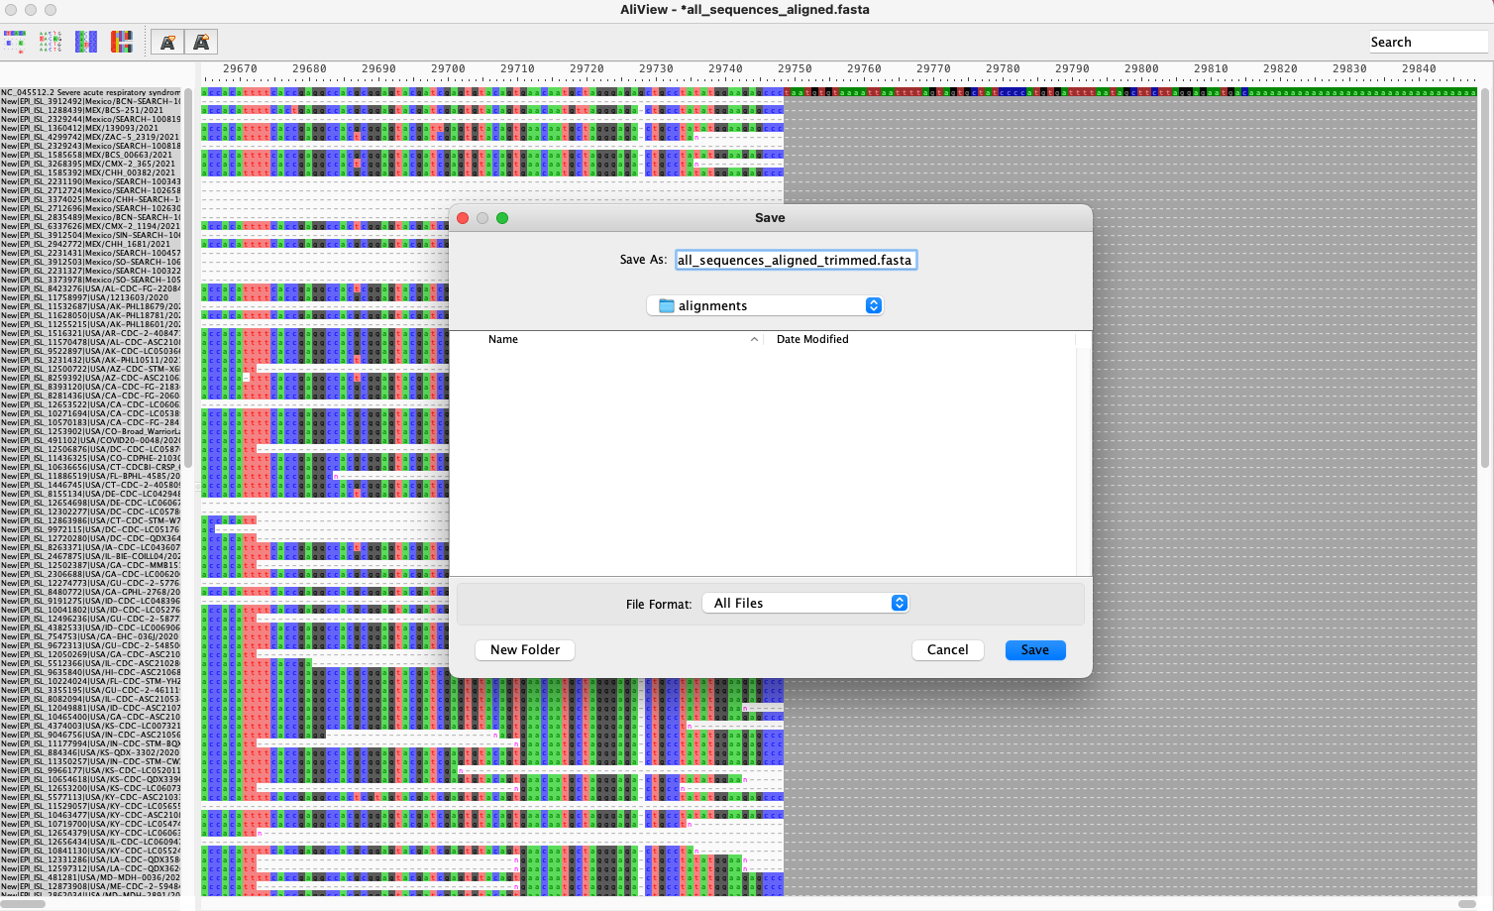

Slide 47
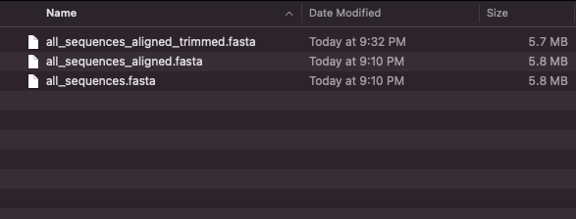
Use trimmed file for phylogenetics, but untrimmed alignment for variant analysis

Slide 48
Genomic epidemiology workflow
1
Build a background dataset
Multiple sequence alignment
Run phylogenetic analysis
2
3
BioRender.com
Pixel True https://www.pixeltrue.com/about, CC BY-SA 4.0, via Wikimedia Commons

Slide 49
Summary
Multiple sequence alignment is required prior to phylogenetic analysis
Alignment with a reference genome is faster and often preferred over reference-free alignment
MAFFT is a common tool for multiple sequence alignment of viral genomes
Always inspect your alignment to ensure quality

